Slide 1

MACHINE LEARNING ACCELERATOR
Tabular Data

Slide 2
Learning Outcomes
Fundamental understanding of data preprocessing, commonly used machine learning (ML) algorithms, and model evaluation
Gain familiarity with standard ML tools and data preprocessing libraries, including methods for detecting and remedying overfitting
Be comfortable talking with scientist partners
Learn about valuable and useful ML resources

Slide 3
Course Overview
Lecture 1
Lecture 2
Lecture 3
Introduction to ML
Model Evaluation
Train-Validation-Test
Overfitting
Exploratory Data Analysis
K Nearest Neighbors (KNN)
Feature Engineering
Tree-based Models
Decision Tree
Random Forest
Hyperparameter Tuning
AWS AI/ML Services
Optimization
Regression Models
Regularization
Boosting
Neural Networks
AutoML

Slide 4


Machine Learning Resources
Notebooks to build, train, and deploy machine learning models quickly
D2L: An interactive deep learning book with code, math, and discussions.
Your
classmates
Collaborate
Share ideas
Connect
Network
Learn

Slide 5
Introduction to
Machine Learning

Slide 6
Machine Learning Applications

Slide 7
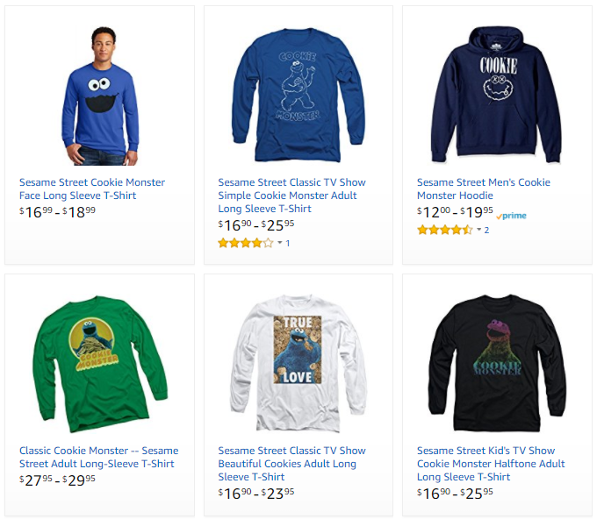
Machine Learning Applications
Business/ML Problem
Description
Example
Ranking
Helping users find the most relevant thing
Ranking algorithm within Amazon Search
Recommendation
Giving users the thing they may be most interested in
Classification
Figuring out what kind of thing something is
Regression
Predicting a numerical value of a thing
Clustering
Putting similar things together
Anomaly Detection
Finding uncommon things

Slide 8

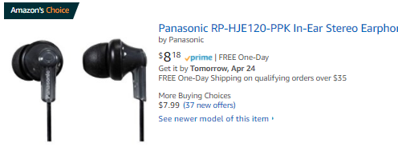
Machine Learning Applications
Business/ML Problem
Description
Example
Ranking
Helping users find the most relevant thing
Recommendations across the website
Amazon’s Choice
Recommendation
Giving users the thing they may be most interested in
Classification
Figuring out what kind of thing something is
Regression
Predicting a numerical value of a thing
Clustering
Putting similar things together
Anomaly Detection
Finding uncommon things

Slide 9

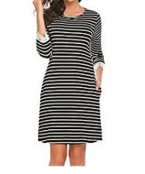
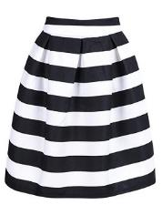
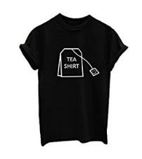
Machine Learning Applications
Business/ML Problem
Description
Example
Ranking
Helping users find the most relevant thing
Product classification for our catalog
Recommendation
Giving users the thing they may be most interested in
Classification
Figuring out what kind of thing something is
High-Low Dress
Straight Dress
Regression
Predicting a numerical value of a thing
Clustering
Putting similar things together
Anomaly Detection
Finding uncommon things
Striped Skirt
Graphic Shirt

Slide 10

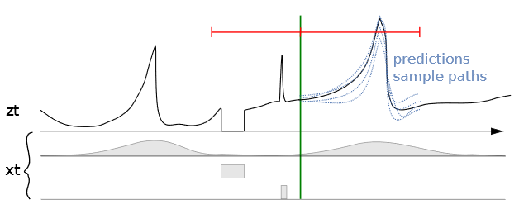
Machine Learning Applications
Business/ML Problem
Description
Example
Ranking
Helping users find the most relevant thing
Predicting sales for specific ASINs
Recommendation
Giving users the thing they may be most interested in
Classification
Figuring out what kind of thing something is
Regression
Predicting a numerical value of a thing
Clustering
Putting similar things together
Anomaly Detection
Finding uncommon things
Seasonality | Out of stock | Promotions

Slide 11
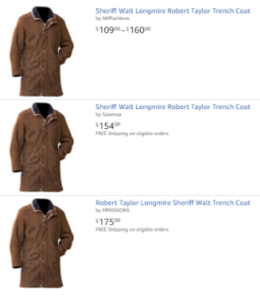
Machine Learning Applications
Business/ML Problem
Description
Example
Ranking
Helping users find the most relevant thing
Close-matching for near-duplicates
Recommendation
Giving users the thing they may be most interested in
Classification
Figuring out what kind of thing something is
Regression
Predicting a numerical value of a thing
Clustering
Putting similar things together
Anomaly Detection
Finding uncommon things

Slide 12


Machine Learning Applications
Business/ML Problem
Description
Example
Example
Ranking
Helping users find the most relevant thing
Fruit freshness
Recommendation
Giving users the thing they may be most interested in
Before
After
Classification
Figuring out what kind of thing something is
Regression
Predicting a numerical value of a thing
Clustering
Putting similar things together
Good
Damage
Serious Damage
Decay
Anomaly Detection
Finding uncommon things

Slide 13
What is Machine Learning?

Slide 14
What is Data Science?
Machine Learning
Wikipedia describes Data Science as:
“a multi-disciplinary field that uses scientific methods, processes, algorithms and systems to extract knowledge and insights from structured and unstructured data.”
MACHINE LEARNING
MATHEMATICS
COMPUTER
SCIENCE
DATA
SCIENCE
STATISTICAL
RESEARCH
DATA
PROCESSING
DOMAIN
EXPERTISE
https://en.wikipedia.org/wiki/Data_science

Slide 15
What is Machine Learning?
“Programming computers to learn from experience should
eventually eliminate the need for much of this detailed
programming effort”
Arthur Samuel (1959) – Computer Scientist
Data
Classical Programming (Rules, if/else, etc.)
Answers
Rules
Data
ML Algorithms
Trained ML Models (Rules)
Answers
Answers
New Similar Data

Slide 16
Why ML? Why now?
Data
larger amounts of data, easy to produce, collect and store
Compute
powerful processing units, hardware acceleration, parallelization
Algorithms
ML frameworks, libraries, improved and more efficient techniques
Data
ML Algorithms
Trained ML Models (Rules)
Answers
Answers
New Similar Data

Slide 17
Machine Learning Lifecycle
Answer
New Data/Re-training
Deployment
Business Problem
Data Processing
Data Collection
Data Preprocessing
Data Visualization
Data Augmentation
Feature Engineering
Etc.
Yes
Model
Training
Tuning
Evaluation
Meets
Business
Goal?
ML Problem Formulation
Algorithm
No

Slide 18
Some Important ML Terms
ML | Statistics/Math/other | Simply Put
Label/Target/y | Dependent/Response/Output Variable | The thing you’re trying to predict
Feature/x | Independent/Explanatory/Input Variable | Data that help you make predictions
Feature Engineering | Transformation | Reshaping data to get more value
1d, 2d,… nd | Dimensionality | Number of features
Model Parameters | Weights | A set of numbers embedded in a model that can predict the labels
Model Training | Optimization | Finding the ‘best’ set of model parameters

Slide 19
Supervised & Unsupervised Learning

Slide 20
Supervised vs. Unsupervised Learning
Business/ML Problem
Description
Ranking
Helping users find the most relevant thing
Supervised Learning
Data is provided with the correct labels
Recommendation
Giving users the thing they may be most interested in
Classification
Figuring out what kind of thing something is
Regression
Predicting a numerical value of a thing
Unsupervised Learning
Data is provided without labels
Clustering
Putting similar things together
Anomaly Detection
Finding uncommon things

Slide 21
Supervised vs. Unsupervised Learning
Supervised Learning
Unsupervised Learning
Data is provided with the correct labels
Model learns by looking at these examples
Data is provided without labels
Model finds patterns in data
Regression (Quantity)
Classification (Category)
K-Means
Collaborative Filtering
PCA
Linear
KNN
Neural Net
Trees
SVM
Logistic

Slide 22
Supervised Learning: Regression
Supervised Learning
Data is provided with the correct labels
Model learns by looking at these examples
Price
Regression (Quantity)
Classification (Category)
SqFootage
Label
Features
Price | Bedrooms | SqFootage | Age
280.000 | 3 | 3292 | 14
210.030 | 2 | 2465 | 6
… | … | … | …
Linear
KNN
Neural Net
Trees
SVM
Logistic

Slide 23
Supervised Learning: Classification
Supervised Learning
Data is provided with the correct labels
Model learns by looking at these examples
Class 1 = star
Class 0 = not star
Feature 2
Regression (Quantity)
Classification (Category)
Feature 1
Label
Features
Star | Points | Edges | Size
1 | 5 | 10< | 750
0 | 0 | >9 | 150
… | … | … | …
Linear
KNN
Neural Net
Trees
SVM
Logistic

Slide 24
Unsupervised Learning: Clustering
Unsupervised Learning
Feature 2
Data is provided without labels
Model finds patterns in data
Feature 1
Features
K-Means
Collaborative Filtering
PCA
Age | Music | Books
21 | Classical | Practical Magic
47 | Jazz | The Great Gatsby
… | … | …

Slide 25
Unsupervised Learning: Clustering
Unsupervised Learning
Feature 2
Data is provided without labels
Model finds patterns in data
Feature 1
Features
K-Means
Collaborative Filtering
PCA
Age | Music | Books
21 | Classical | Practical Magic
47 | Jazz | The Great Gatsby
… | … | …

Slide 26
Sample ML Problem

Slide 27
Food Delivery Problem
John loves to order his food online for home and work.
He wants to predict whether his order will be on time or late beforehand.
He logged his previous 45 orders.
BadWeather | RushHour | MilesFromRestaurant | UrbanAddress | Late
10 | 1 | 5 | 1 | 0
78 | 0 | 7 | 0 | 1
14 | 1 | 2 | 1 | 0
58 | 1 | 4.2 | 1 | 1
82 | 0 | 7.8 | 0 | 0
… | … | … | … | …
Two classes: 1/late and 0/on time

Slide 28
Food Delivery Problem
K Nearest Neighbors (KNN) predicts new data points based on K similar records from a dataset.
Late
On time
What class does belong to?
?
Miles from Restaurant
?
Bad Weather

Slide 29
Food Delivery Problem
K Nearest Neighbors (KNN) predicts new data points based on K similar records from a dataset.
Late
On time
What class does belong to?
Look at the K closest data points:
Choose K = 3
Calculate the distances from to all data points
Find the K nearest neighbors
Pick the majority class:
?
?
Miles from Restaurant
?
Bad Weather

Slide 30
Food Delivery Problem Hands-on
Let’s use John’s food delivery example, and train a K Nearest Neighbors model to predict the new data point.
Late
On time
Miles from Restaurant
?
Bad Weather
MLA-TAB-Lecture1-Sample-Model.ipynb

Slide 31
Model Evaluation

Slide 32
Regression Metrics
Metrics | Equations
Mean Squared Error (MSE)
Root Mean Squared Error (RMSE)
Mean Absolute Error (MAE)
R Squared (R²)
: Data values
: Predicted values
: Mean value of data values,
: Number of data records

Slide 33
Classification Metrics
Prediction
True Positive: Predicted ‘Positive’
when the actual is ‘Positive’
False Positive: Predicted ‘Positive’
when the actual is ‘Negative’
False Negative: Predicted ‘Negative’
when the actual is ‘Positive’
True Negative: Predicted ‘Negative’
when the actual is ‘Negative’
Positive
Negative
True Positive
False Negative
Positive
18
3
True State
False Positive
True Negative
‘Positive’ = star
‘Negative’ = not star
Negative
1
15

Slide 34
Classification Metrics: Accuracy
Prediction
Positive
Negative
Accuracy*: The percent (ratio) of cases classified correctly
True Positive
False Negative
Positive
18
3
True State
False Positive
True Negative
Negative
1
15

Slide 35
Classification Metrics: Accuracy
Prediction
Positive
Negative
High Accuracy Paradox: Accuracy is misleading when dealing with imbalanced datasets - few True Positives, the ‘rare’ class, and many True Negatives, the ‘dominant’ class. High Accuracy even when few True Positives.
True Positive
False Negative
Positive
2
8
True State
False Positive
True Negative
Negative
2
88

Slide 36
Classification Metrics: Precision
Prediction
Positive
Negative
Precision*: Accuracy of a predicted positive outcome
True Positive
False Negative
Positive
2
8
True State
False Positive
True Negative
Negative
2
88

Slide 37
Classification Metrics: Recall
Prediction
Positive
Negative
Recall*: Measures model’s ability to predict a positive outcome
True Positive
False Negative
Positive
2
8
True State
False Positive
True Negative
Negative
2
88

Slide 38
Classification Metrics: F1 Score
F1 Score*: A combined metric, the harmonic mean of Precision and Recall.
Recall
F1 Score
Low when one or both of the Precision and Recall are low
High when both Precision and Recall are high
Precision

Slide 39
Train – Validation – Test
Datasets

Slide 40
Training – Validation – Test Sets
Original Dataset
Training Set
Training Set
(used to train the model)
Validation Set
(used for unbiased evaluation of the model)
Test Set
Test Set
(used for final evaluation of the model)
Learning
Train, tune and validate the model (multiple times!)
Testing
(Final) Test the model
The test set is not available to the model for learning, it is only used to ensure that the model generalizes well on new “unseen” data.

Slide 41
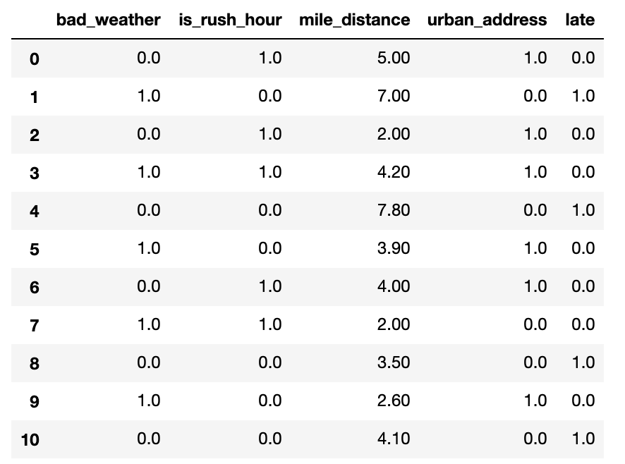
Training – Validation – Test Sets
Original Dataset
Training Set
Training Set
(used to train the model)
Validation Set
(used for unbiased evaluation of the model)
Test Set
Test Set
(used for final evaluation of the model)
Learning
Train, tune and validate the model (multiple times!)
Testing
(Final) Test the model
It is good practice to shuffle the dataset before the split to avoid bias in the resulting sets.
Training Set
Validation Set
Test Set

Slide 42
K-fold Cross Validation ( K = 5)
K-fold Cross-Validation (CV) is a validation technique to see how well a trained model generalizes to an independent validation set.
Use K different holdout samples to validate the model, each time training with the remainder samples:
Split the training dataset into K independent folds.
Repeat the following K times:
Set aside K^{th} fold of the data for validation.
Train the model on the other folds, the training set.
Test the model on the validation set.
Average or combine the model performance metrics.
1st
2nd
3rd
4th
5th
Training
Training
Training
Training
Validation
Training
Training
Training
Validation
Training
Training Set
Validation
Training
Training
Training
Training
Training
Validation
Training
Training
Training
Validation
Training
Training
Training
Training
Average or combine validation performance metrics

Slide 43
Underfitting & Overfitting

Slide 44
Model Evaluation: Underfitting
Underfitting: Model is not good enough to describe the relationship between the input data (x₁, x₂) and output y: {Class 1, Class 2}.
Model is too simple to capture important patterns of training data.
Model will perform poorly on training and validation (and/or test).
Class 1
Class 2
x₂
x₁

Slide 45

Model Evaluation: Overfitting
Overfitting: Model memorizes or imitates training data, and fails to generalize well on new “unseen” data (test data).
Model is too complex.
Model picks up the noise instead of the underlying relationship.
Model will perform well on training, but poorly on validation (and/or test).
Class 1
Class 2
x₂
x₁

Slide 46
Model Evaluation: Good Fit
Appropriate fitting: Model captures the general relationship between the input data (x₁, x₂) and output y: {Class 1, Class 2}.
Model not too simple, not too complex.
Model picks up the underlying relationship rather than the noise in the training.
Model will perform good enough on training and validation (and/or test).
Class 1
Class 2
x₂
x₁

Slide 47
Overfitting Hands-on
Let’s use John’s food delivery example one more time.
We train a K Nearest Neighbors model and analyze overfitting.
Late
On time
Miles from Restaurant
?
Bad Weather
MLA-TAB-Lecture1-Sample-Model.ipynb

Slide 48
Exploratory Data Analysis (EDA)

Slide 49
Exploratory Data Analysis
Exploratory Data Analysis (EDA) is an approach to analyze a dataset and capture main characteristics of it.
Collect or aggregate data
Perform initial investigations to discover patterns, spot anomalies, test hypothesis and check assumptions
Summary statistics
Graphical/visual representations (histograms, plots)
Process data to produce meaningful information

Slide 50
Descriptive Statistics
Overall statistics -
Number of instances (i.e. number of rows)
Number of features (i.e. number of columns)
Univariate statistics (single feature)
Statistics for numerical features (mean, variance, histogram) -
Statistics for categorical features (histograms, mode, most/least frequent values, percentage, number of unique values)
Histogram of values -
Target statistics
Class distribution -
Multivariate statistics (more than one feature)
Correlations -
df.head(), df.shape, df.info()
df.describe(), hist(df[feature])
df[feature].value_counts() or seaborn’s distplot()
df[target].value_counts() or np.bincount(y)
df.plot.scatter(feature1, feature2), df[[feature1, feature2]].corr()

Slide 51
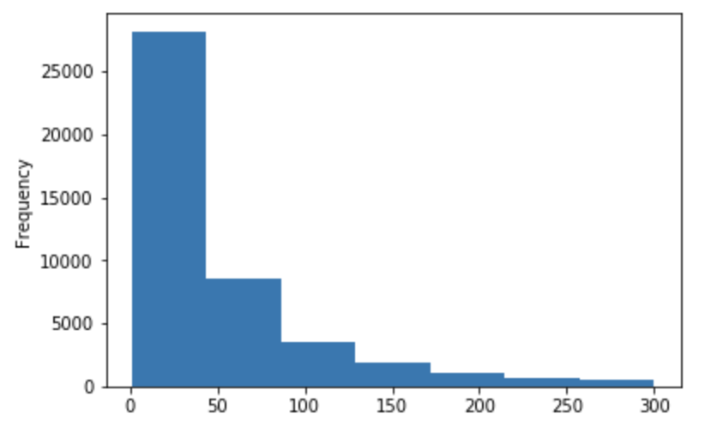
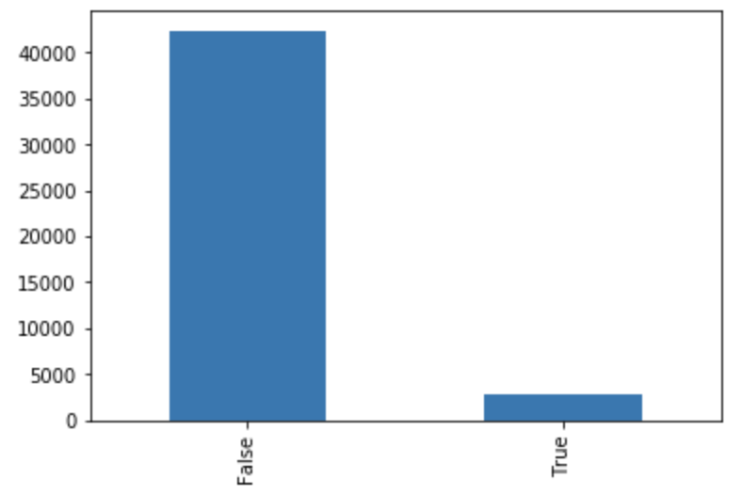
Univariate Statistics: Histograms
Numerical features:
Categorical features:
import matplotlib.pyplot as plt
df[num_feature].plot.hist(bins = 7)
plt.show()
import matplotlib.pyplot as plt
df[cat_feature].value_counts().plot.bar()
plt.show()

Slide 52
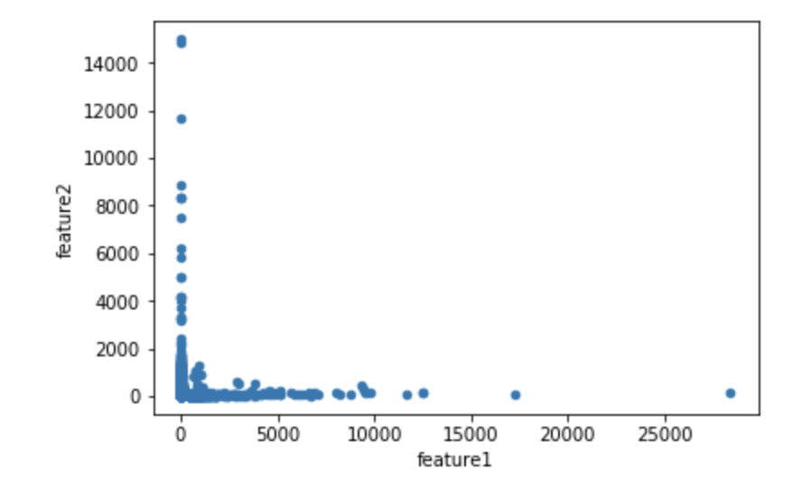
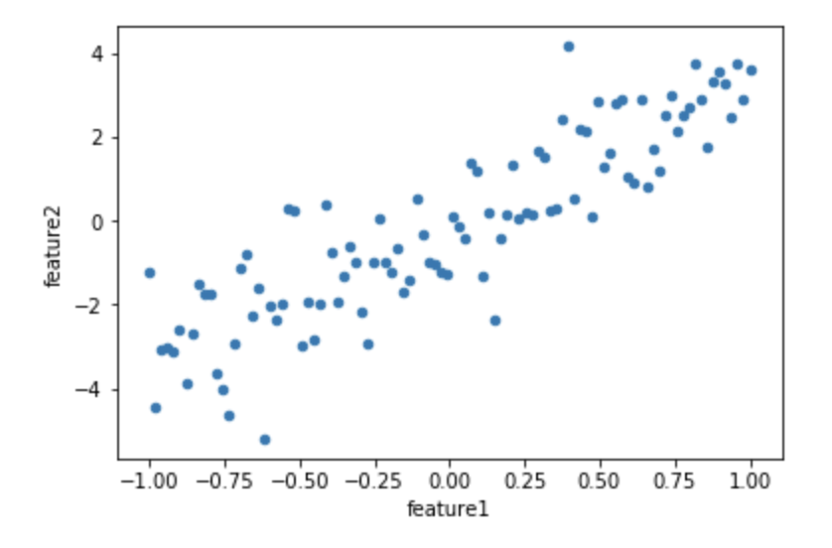
Correlations: Scatterplot
Correlations: How strongly pairs of features are related.
df.plot.scatter(feature1,feature2)
plt.show()
Scatterplot matrices visualize feature-target and feature-feature pairwise relationships.

Slide 53
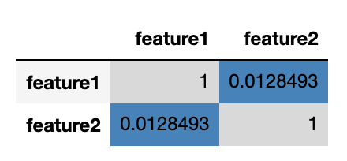
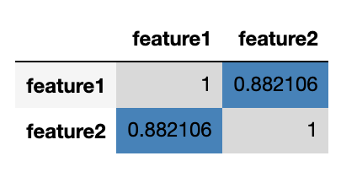
Correlations: Correlation Matrix
Correlations: How strongly pairs of features are related.
cols = [feature1, feature2]
df[cols].corr()
Correlation matrices measure the linear dependence between features; easier to read; can use heat-maps.
Correlation values are between -1 and 1: -1 means perfect negative correlation, 1 means perfect positive correlation, and 0 means there is no relationship between the two variables.

Slide 54
Correlations
Highly correlated (positive or negative) features might degrade performance of some ML models, such as linear and logistic regression models.
Select one of the correlated features and discard the other(s).
Other ML models, like decision trees, are mostly immune to this problem.
While, highly target-correlated (positive or negative) features might improve the performance of linear and logistic regression models.

Slide 55
Imbalanced Datasets

Slide 56
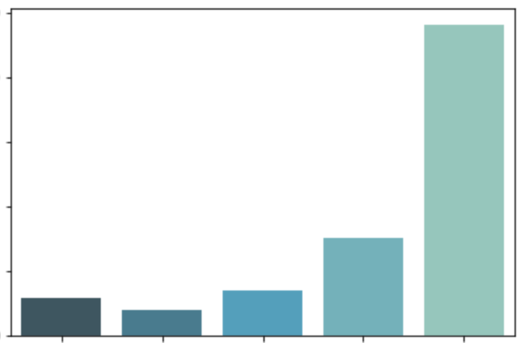
Class Imbalance
Star rating count in millions
Number of samples per class is not equally distributed.
The ML model may not work well for the infrequent classes.
Examples:
Fraud Detection
Anomaly Detection
Medical Diagnosis
2.5
2
1.5
Star rating count
1
0.5
1
2
3
4
5
Star rating
Amazon review dataset: The number of 5 star reviews almost equals the total of the other 4 types of star reviews combined.

Slide 57
Class Imbalance
How to address class imbalance problems?
Down-sampling
Up-sampling
Data generation
Sample weights
Reduce the size of the dominant or frequent class(es).
Increase the size of the rare or small class(es).
Create new records, similar but not identical.
For a model that uses a cost function, assign higher weights to rare class(es) and lower weights to dominant class(es).

Slide 58
Missing Data

Slide 59
Handling Missing Data
Drop rows and/or columns with missing values: Remove those rows and/or columns from the dataset.
Less training data samples and/or less features can lead to overfitting/underfitting
Impute (fill-in) the missing values:
Average imputation on missing numerical values: Replace with the average value in the column -
Common point imputation on missing categorical values: Replace with the most common value for that column -
Placeholder: Assign a common value for missing data location
Advanced imputation: Predict missing values from complete samples using ML techniques. For example, AWS Datawig uses neural networks to predict tabular data missing values https://github.com/awslabs/datawig
df[‘col'].fillna((df['col'].mean()))
df['col'].fillna((df['col'].mode()))

Slide 60
SimpleImputer in sklearn
SimpleImputer: sklearn imputation transformer for completing missing values -
SimpleImputer(missing_values=nan, strategy='mean', fill_value=None)
numerical data:
Strategy = “mean”, replace missing values using the mean along each column
Strategy = “median”, replace missing values using the median along each column
numerical or categorical data:
Strategy = “most_frequent”, replace missing using the most frequent value along each column
Strategy = “constant”, replace missing values with fill_value
.fit(), .transform()

Slide 61
EDA Hands-on
Let’s read our review dataset and analyze it.
MLA-TAB-Lecture1-EDA.ipynb

Slide 62
K Nearest Neighbors (KNN)

Slide 63
K Nearest Neighbors (KNN)
K Nearest Neighbors (KNN) predicts new data points based on K similar records from a dataset.
Class
Class
What class does belong to?
Look at the K closest data points:
Choose K = 3
?
?

Slide 64
K Nearest Neighbors (KNN)
K Nearest Neighbors (KNN) predicts new data points based on K similar records from a dataset.
Class
Class
What class does belong to?
Look at the K closest data points:
Choose K = 3
Calculate the distances from to all data points
?
?
?

Slide 65
K Nearest Neighbors (KNN)
K Nearest Neighbors (KNN) predicts new data points based on K similar records from a dataset.
Class
Class
What class does belong to?
Look at the K closest data points:
Choose K = 3
Calculate the distances from to all data points
Find the K nearest neighbors
?
?
?

Slide 66
K Nearest Neighbors (KNN)
K Nearest Neighbors (KNN) predicts new data points based on K similar records from a dataset.
Class
Class
What class does belong to?
Look at the K closest data points:
Choose K = 3
Calculate the distances from to all data points
Find the K nearest neighbors
Pick the majority class:
?
?
?

Slide 67
KNN in sklearn
KNeighborsClassifier: sklearn classifier implementing the K Nearest Neighbors vote -
KNeighborsClassifier(n_neighbors=5, metric='minkowski’, p=2)
n_neighbors: How to choose K?
metric: How to calculate distances?
The full interface is larger.
.fit(), .predict()

Slide 68
KNN: Choosing K
How to choose K?
Use a validation set to select an appropriate value for K.
K = 1, =
K = 3, =
K = 5, =
K = 7, =
?
?
?
?
?
?
?
?

Slide 69
KNN: Choosing K
What is the effect of K on the model?
Low K (like K=1): predictions based on only one data sample could be greatly impacted by noise in the data (outliers, mislabeling)
Large K: more robust to noise, but the nearest “neighborhood” can get too inclusive, breaking the “locality”, and a class with only a few samples in it will always be outvoted by the other classes
Rule of thumb in selecting K:
K = , where is the number of data samples

Slide 70
KNN: Choosing the Distance Metric
Data samples are considered similar to each other if there are close to each other, as determined by a specific distance metric.
How to choose the distance metric?
Real-valued features:
Similar types: p = 2, Euclidean
Mixed types (lengths, ages, salaries): p = 1, Manhattan (taxi-cab)
Binary-valued features: Hamming
number of positions where the values of two vectors are different
Boolean-valued features: Jaccard
ratio of shared values to the total number of values of two vectors
High dimensional feature space: cosine similarity
the angle between two vectors (similarity irrespective of their sizes)

Slide 71
KNN: Curse of Dimensionality
With too many features, KNN becomes computationally expensive and difficult to solve.
Data closeness
Data sparsity
?
?
?

Slide 72
KNN: Feature Scaling
Features should be on the same scale when using KNN.
Unscaled features: closer to
Scaled features: closer to
?
?
10
(K = 1)
1
( almost halved)
5
?
0.5
?
d2 = 2
d2 = 0.2
3
0.3
0
80 85
0
1
100
0.80 0.85
d1 = 5
( changed less)
d1 = 0.05

Slide 73
Feature Scaling

Slide 74
Feature Scaling
Motivation: Many algorithms are sensitive to features being on different scales, like metric-based algorithms (KNN, K Means) and gradient descent-based algorithms (regression, neural networks)
Note: tree-based algorithms (decision trees, random forests) do not have this issue
Solution: Bring features to the same scale
Common choices (both linear):
Mean/variance standardization
MinMax scaling

Slide 75
Standardization in sklearn
StandardScaler: sklearn scaler, scaling values to be centered around mean 0 with standard deviation 1 -
.fit(), .transform()
Transform:
from sklearn.preprocessing import StandardScaler
stdsc = StandardScaler()
raw_data = np.array([[-3.4], [4.5], [50], [24], [3.4], [1.6]])
scaled_data = stdsc.fit_transform(raw_data)
print(scaled_data.reshape(1,-1))

Slide 76
MinMax Scaling in sklearn
MinMaxScaler: sklearn scaler, scaling values so that minimum value is 0 and maximum value is 1 -
.fit(), .transform()
Transform:
from sklearn.preprocessing import MinMaxScaler
minmaxsc = MinMaxScaler()
raw_data = np.array([[-3.4], [4.5], [50], [24], [3.4], [1.6]])
scaled_data = minmaxsc.fit_transform(raw_data)
print(scaled_data.reshape(1,-1))

Slide 77
Pipeline (sklearn)

Slide 78
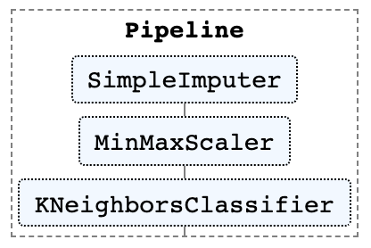
Pipeline in sklearn
Pipeline: sklearn sequential data transforms with a final estimator (prevents data leakage) -
.fit(), .predict()
Pipeline(steps, verbose=False)
y_train
pipeline = Pipeline([
(‘imputer’, SimpleImputer(strategy='mean’)),
(‘scaler’, MinMaxScaler()),
(‘clf’, KNeighborsClassifier(n_neighbors = 3))
])
pipeline.fit(X_train, y_train)
predictions = pipeline.predict(X_test)
X_train
X_test
pipeline.fit
pipeline.predict
.fit_transform
.transform
.fit_transform
.transform
.fit
.predict

Slide 79
Putting it all together
In this notebook, we work with our review dataset to predict the target field
The notebook covers the following tasks:
Exploratory Data Analysis
Splitting dataset into training and test sets
Numerical features processing
Train a K Nearest Neighbors Classifier
Check the performance metrics on test set
MLA-TAB-Lecture1-KNN.ipynb

Slide 80
Looking Ahead: Lecture 2

Slide 81
Looking Ahead: Lecture 2
Feature Engineering
Encoding: Handling categorical data
Text Vectorization: Handling text data
Tree Models and Ensemble Learning: More advanced ML models
Hyperparameter Tuning: Tune ML models for best performance
AWS SageMaker: Amazon ML tool that helps you build, train and deploy ML models on AWS

